Slide 1
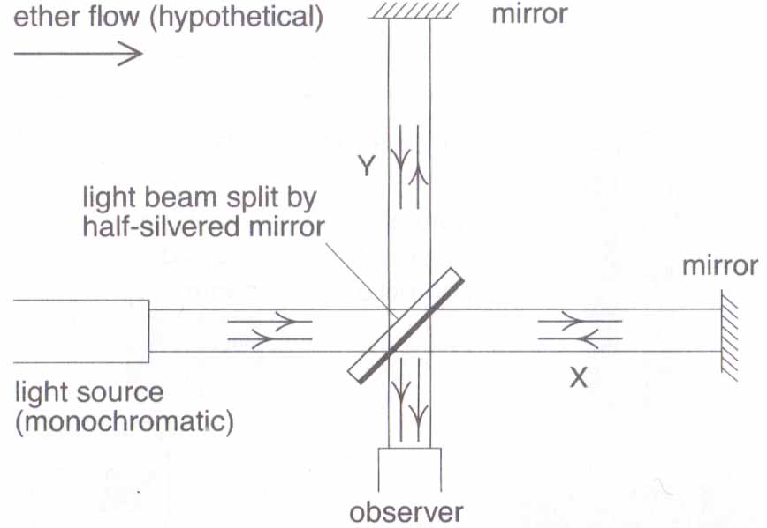
Relativity
The Ether should flow past the Earth as the Earth moves through space.
Michelson / Morley and the Ether
Beams X and Y travel along the 2 different pathways and recombine to form an interference pattern.
In an Ether flow, as shown, travel time for X should be longer than Y’s.
When rotated 90, travel time for Y should be longer than X’s.
No shift was detected. Measured value for speed of light is invariant.
Animation 1
Animation 2

Slide 2
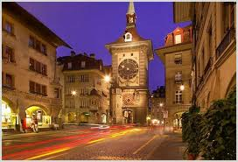
Einstein’s interpretation of the M-M results was that there was no ether, but how can the measured speed of light be the same?
‘he remembered riding in a street car in Bern and looking back at the famous clock tower. He then imagined what would happen if his street car raced away at the speed of light. He realized that the clock would appear stopped since light could not catch up to the street car, but his own watch would beat normally’.
Then it suddenly hit him. Einstein recalled, “A storm broke loose in my mind. Time can beat at different rates through-out the Universe, depending on how fast you moved.

Slide 3
Relativity
Einstein stated that motion could only be relative to the observer’s frame of reference. From this he developed his Special Theory of Relativity.
link
I liked this one, nice and simple!.
1. Physical laws are the same in all inertial (unaccelerated) frames of reference.
link
A frame of reference is simply the place where the observer is taking the measurements.
Film clips and
M_M expt
2. The speed of light in a vacuum has the same measured value in all inertial frames of reference.

Slide 4
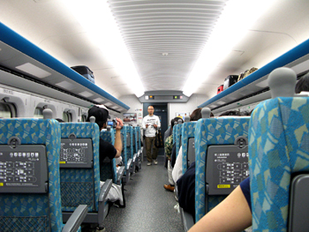
You are on a plane travelling at 800 kmhour⁻¹ and you drop a plate.
The plate falls vertically down onto your foot – just as it would if you were on the ground.
You jump vertically up in the air and land on the floor exactly on the spot you left – not further back!
You call to your friend at the back of the plane and the sound travels at 346ms⁻¹ through the air.
These effects would be exactly the same at any constant speed, even in a spacecraft travelling at 90% of the speed of light.

Slide 5
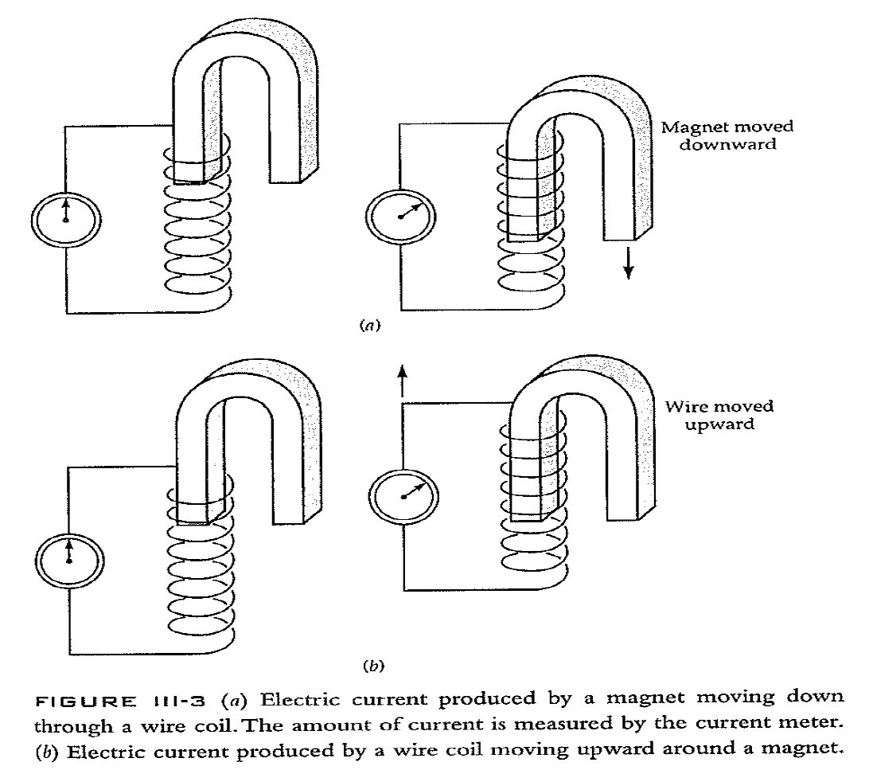
Relative Motion

Slide 6
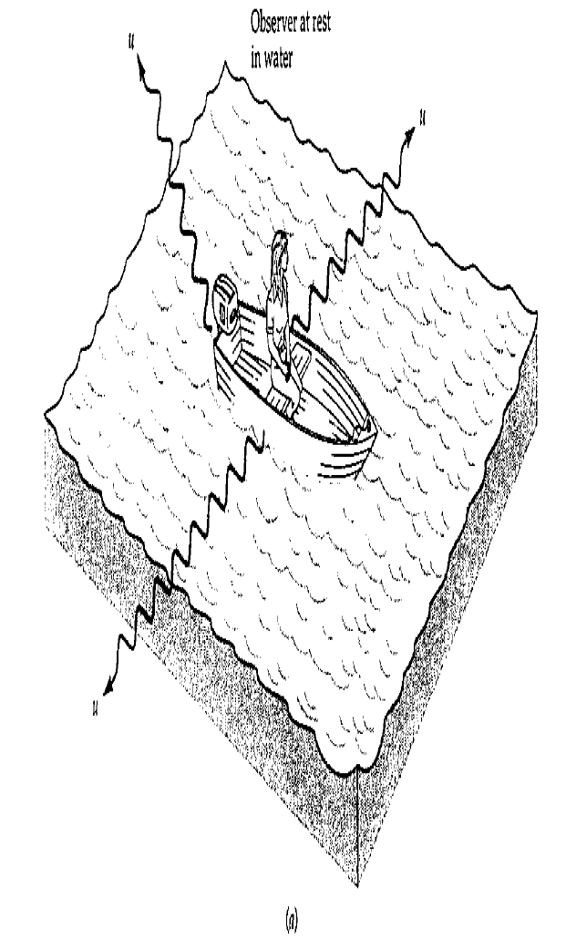
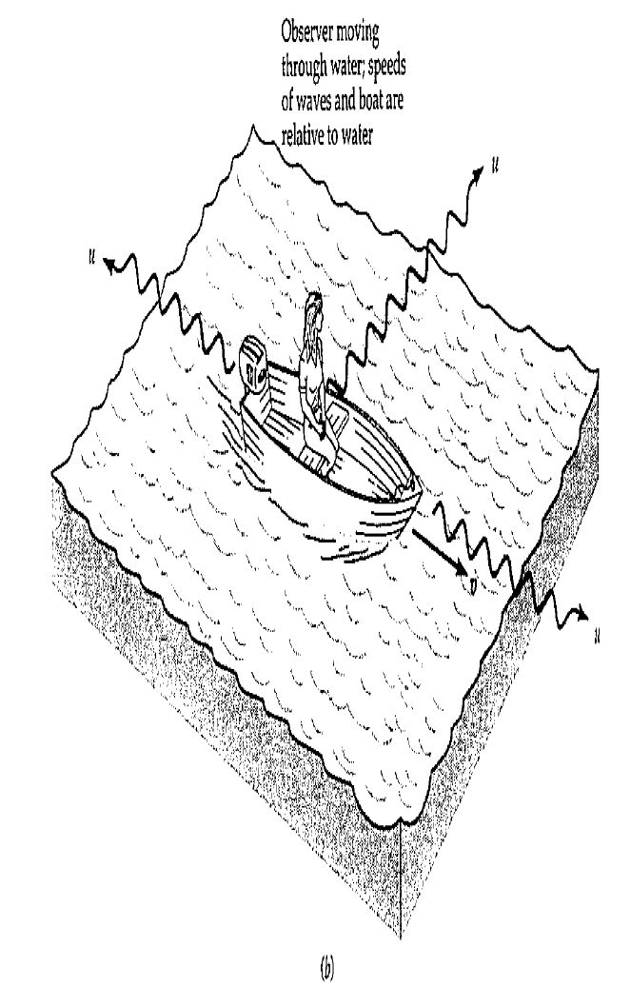
Relative motion
Observer at rest, water waves travel outwards at speed, u, relative to lake and observer, in all directions.
Observer moving at speed, v, water waves travel outwards at speed, u, relative to lake, but at (u-v) forwards,
and (u+v) backwards
relative to the observer.

Slide 7
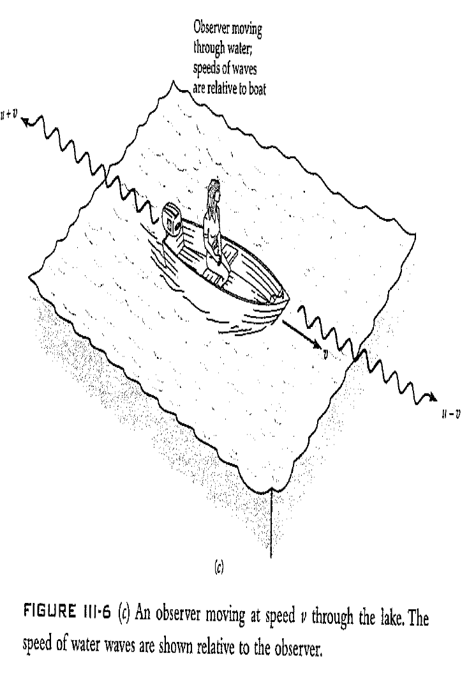
Our observer can also determine her velocity through the water by averaging the speeds of the water waves in the forwards and backward directions.
Michelson and Morley, in 1887, attempted to determine the velocity of the Earth through the ether in this way.
They failed to detect any difference in the speed of light in any direction. Michelson won the Nobel prize (1907) for this nul result!

Slide 8
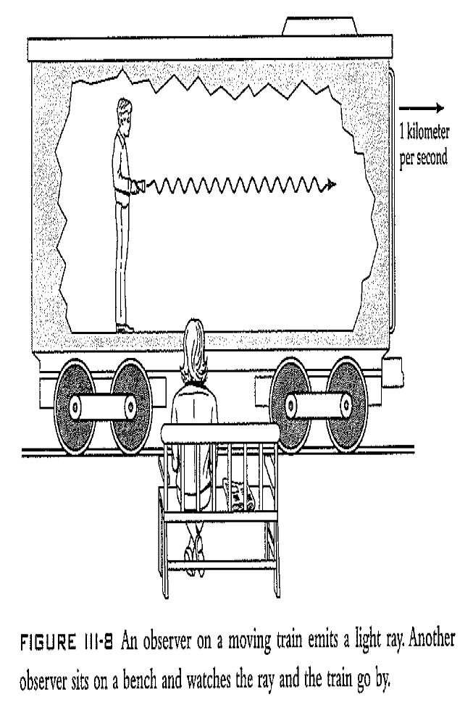
Both observers measure the speed of light to be the same!

Slide 9
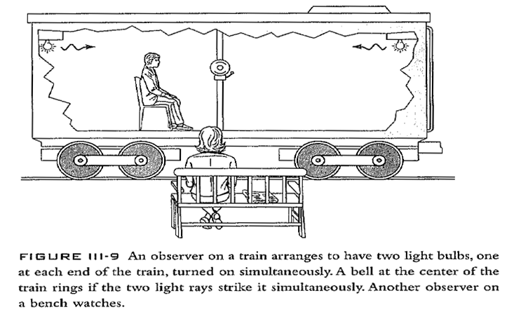
Observer on train sees both lamps come on simultaneously. What does the observer on the bench see if the bell rings?
As the bell rings, the light rays must have struck at the same time. As the speed of light is measured to be the same in both directions and the train is moving to the right, the observer must see the left hand lamp come on before the right hand lamp.

Slide 10
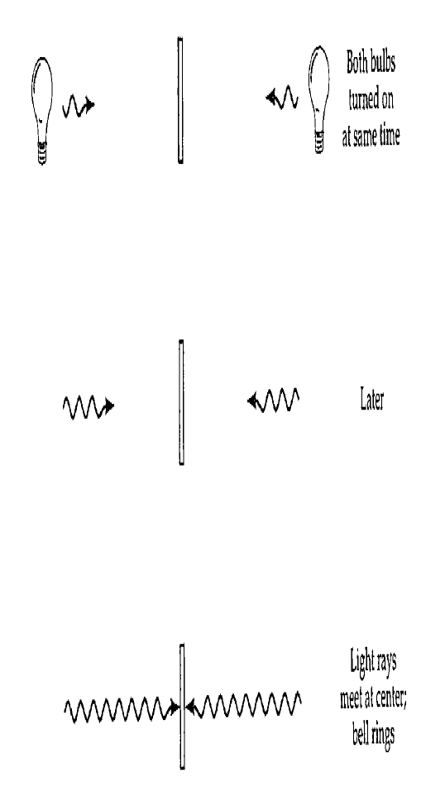
Observer in train

Slide 11
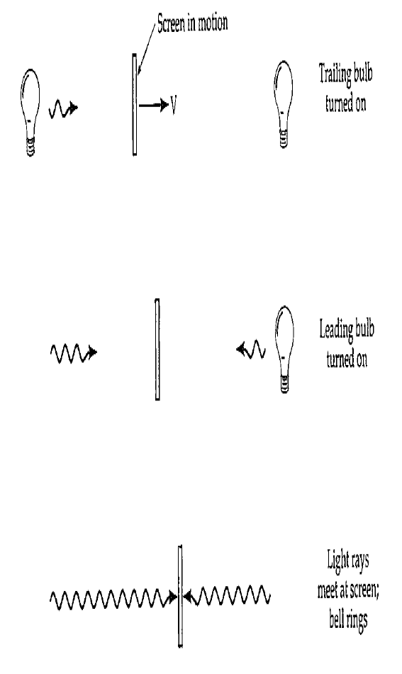
Observer on bench

Slide 12
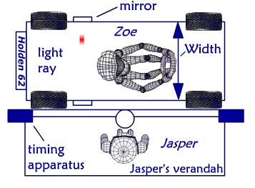
Einstein’s insights from these assumptions.
Length and time measurements are not absolute, rather, they depend on the relative motion of the observer.
Link

Slide 13
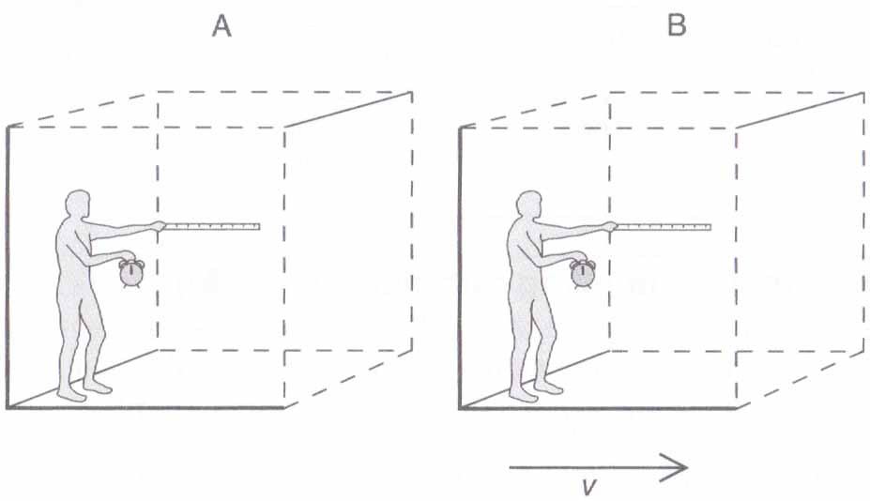
Relative Motion
Frame B is moving to the right with respect to Frame A
link
Observer B is stationary in his own reference frame (B).
To an observer in reference frame A:
Time in B appears to pass more slowly (time dilation)
The length of the rule appears shorter ( length contraction)
Additionally, the mass of objects in B are increased with respect to A.

Slide 14
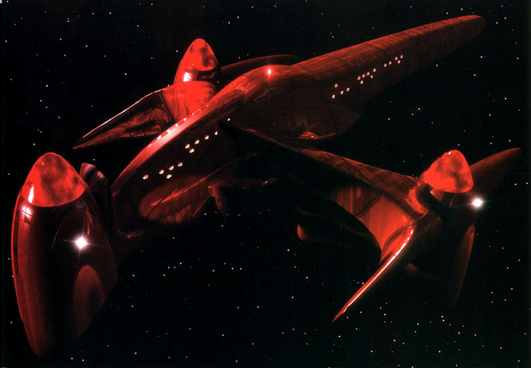
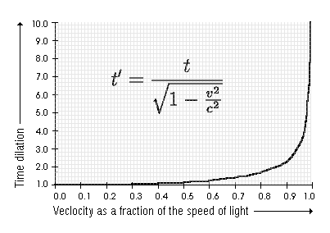
Time dilation
Where t’ is the time for the observer and t is the time on the Vulcan starship, Surak.
Spock is travelling on the Vulcan starship Surak at 0.95c across a nebula of width 5.60 ly.
For an observer at the space base, how much time passes while Surak crosses the nebula?
How long does the journey seem to Spock?
5.89 years
1.84 years

Slide 15
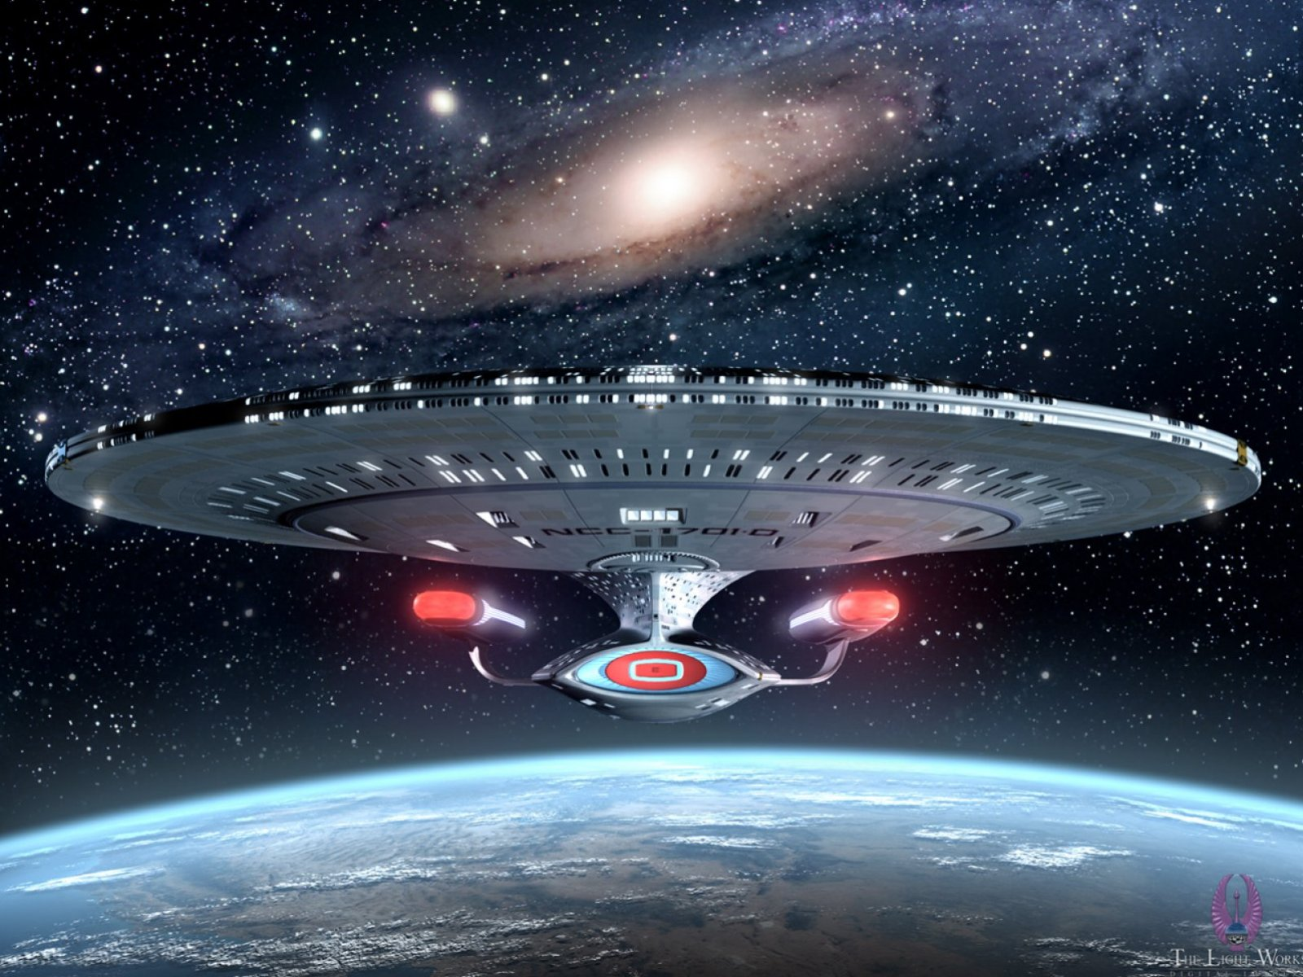
Length contraction due – due to contraction of space
Which dimensions of Enterprise would change if she were heading straight towards you at Relativistic speed?
Length from front to back, only, would seem shorter.

Slide 16
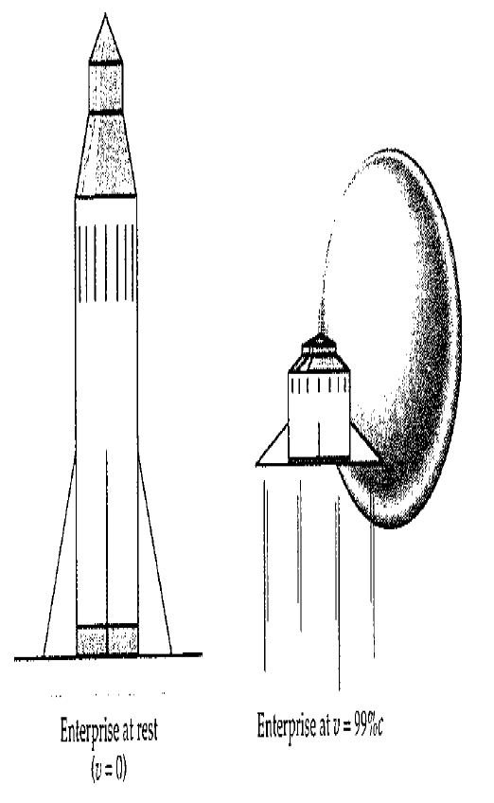

Slide 17
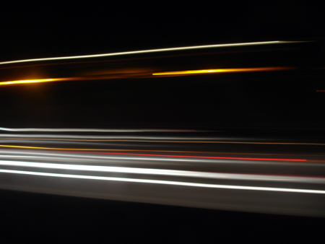
Einstein concluded that the speed of light was the ultimate velocity in the Universe.
Imagine a bullet at 90% the speed of light inside a rocket travelling at 90% the speed of light.
Einstein showed that because metre sticks are shortening and time is slowing down, the sum of these velocities is actually close to 99% the speed of light.
No matter how hard you tried, you could never exceed the speed of light.

Slide 18
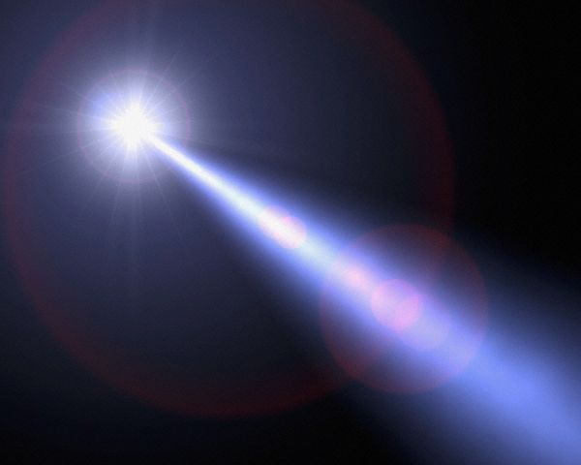
Mass increase
As work is done to increase the speed of an object, to relativistic speeds, some of the energy supplied goes into increasing the mass of the object.
As the object becomes more massive, a proportionately larger force is needed to produce an increment of acceleration. Thus it becomes harder and harder to accelerate the object.
(F = ma)
As the work done on the object to accelerate it is W = F.s, the energy required to accelerate it is proportionately greater.
As the object approaches the speed of light the force needed to accelerate it approaches infinity, therefore it is impossible to reach the speed of light!

Slide 19
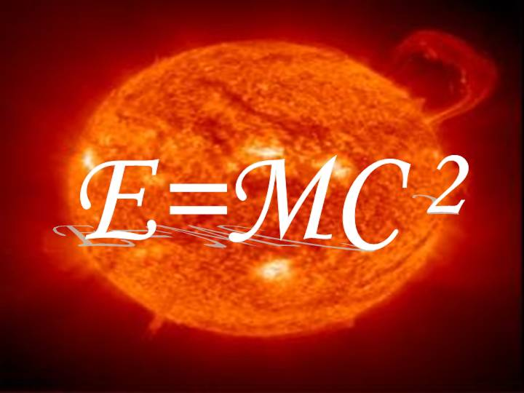
Einstein could show that the mass increased the faster it travelled. Thus the energy of motion was being transformed into increasing the mass.
Thus matter and energy are interchangeable.

